Slide 1
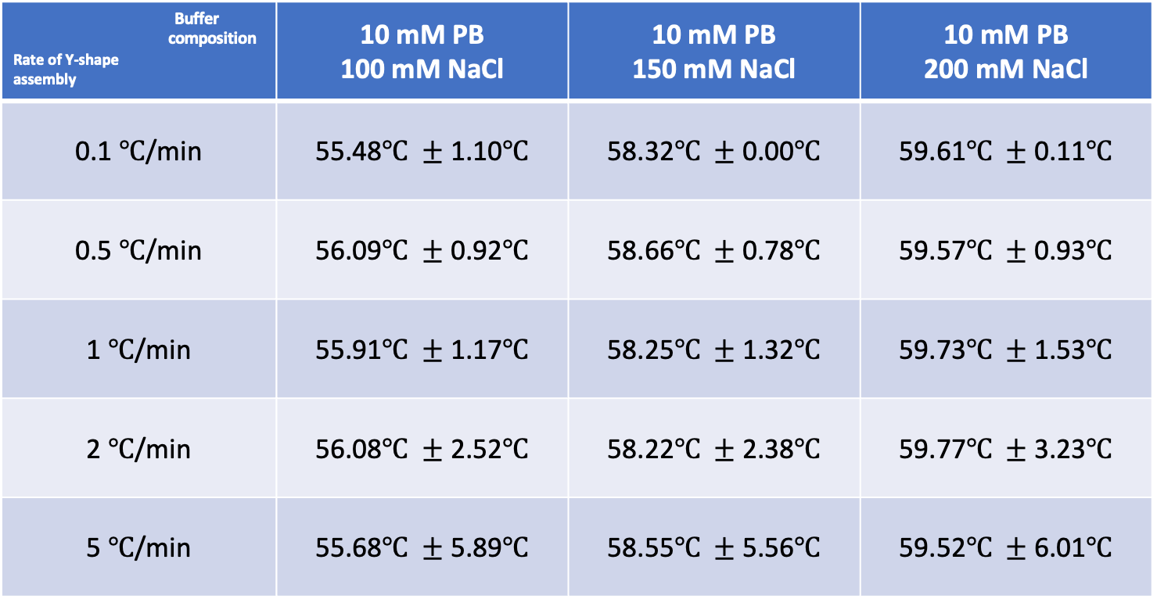
Y-Shape Melting Temperatures (vary T-rate)
Buffer composition Rate of Y-shape assembly | 10 mM PB 100 mM NaCl | 10 mM PB 150 mM NaCl | 10 mM PB 200 mM NaCl
0.1 $℃$/min | 55.48$℃ ±$ 1.10$℃$ | 58.32$℃ ±$ 0.00$℃$ | 59.61$℃ ±$ 0.11$℃$
0.5 $℃$/min | 56.09$℃ ±$ 0.92$℃$ | 58.66$℃ ±$ 0.78$℃$ | 59.57$℃ ±$ 0.93$℃$
1 $℃$/min | 55.91$℃ ±$ 1.17$℃$ | 58.25$℃ ±$ 1.32$℃$ | 59.73$℃ ±$ 1.53$℃$
2 $℃$/min | 56.08$℃ ±$ 2.52$℃$ | 58.22$℃ ±$ 2.38$℃$ | 59.77$℃ ±$ 3.23$℃$
5 $℃$/min | 55.68$℃ ±$ 5.89$℃$ | 58.55$℃ ±$ 5.56$℃$ | 59.52$℃ ±$ 6.01$℃$
Rate of heating/cooling $↑$ → hysteresis (uncertainty in melting temperature estimate) $↑$

Slide 2
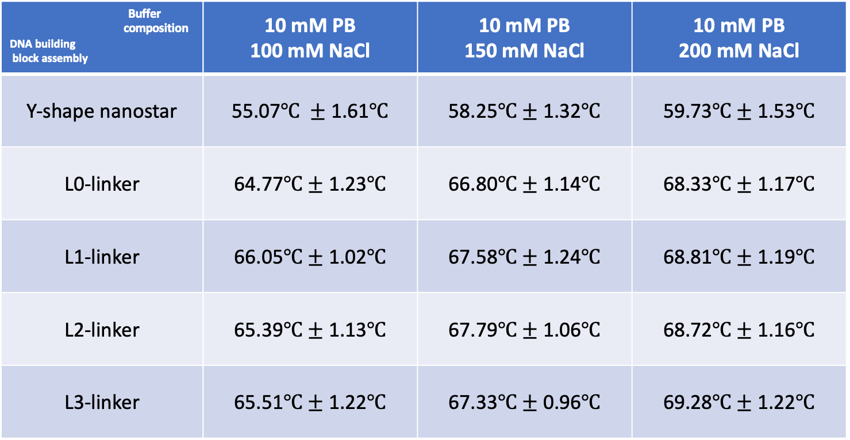
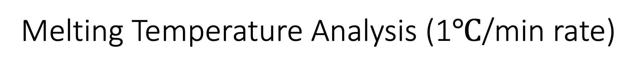
Melting Temperature Analysis (1$℃$/min rate)
Buffer composition DNA building block assembly | 10 mM PB 100 mM NaCl | 10 mM PB 150 mM NaCl | 10 mM PB 200 mM NaCl
Y-shape nanostar | 55.07$℃ ±$ 1.61$℃$ | 58.25$℃±$ 1.32$℃$ | 59.73$℃±$ 1.53$℃$
L0-linker | 64.77$℃±$ 1.23$℃$ | 66.80$℃±$ 1.14$℃$ | 68.33$℃±$ 1.17$℃$
L1-linker | 66.05$℃±$ 1.02$℃$ | 67.58$℃±$ 1.24$℃$ | 68.81$℃±$ 1.19$℃$
L2-linker | 65.39$℃±$ 1.13$℃$ | 67.79$℃±$ 1.06$℃$ | 68.72$℃±$ 1.16$℃$
L3-linker | 65.51$℃±$ 1.22$℃$ | 67.33$℃±$ 0.96$℃$ | 69.28$℃±$ 1.22$℃$
Salt concentration $↑$→ Melting temperature (interaction strength / degree of binding) $↑$

